Slide 1
DSA 8301 – Stat Inference in Big Data
Lecture 4
Fitting Models to Data - II

Slide 2
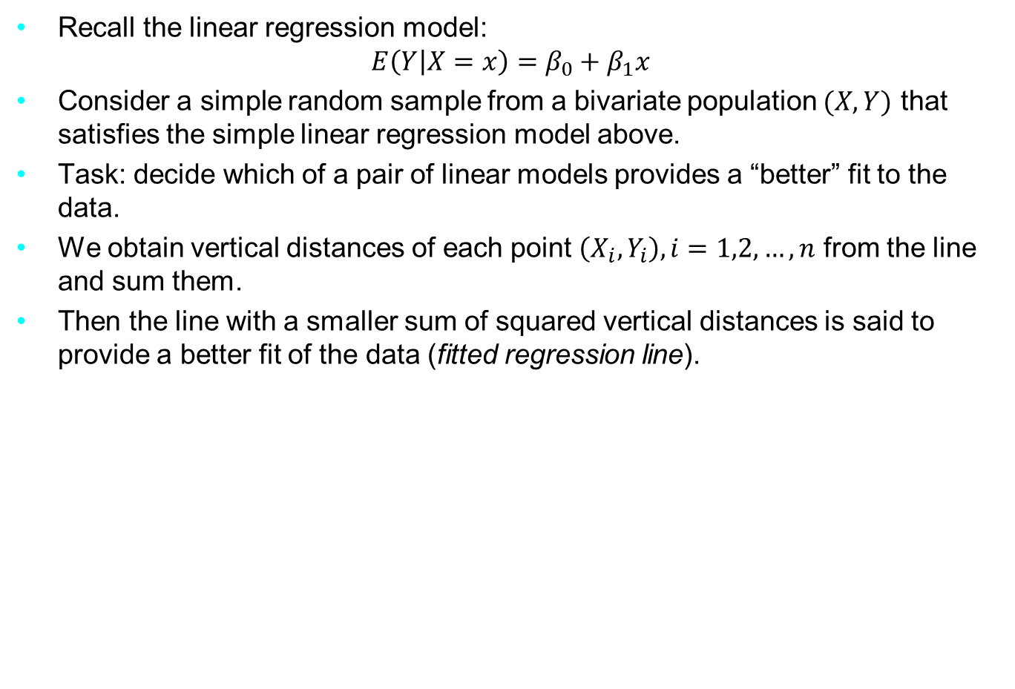
Method of Least Squares
Recall the linear regression model:
$$E\left(Y | X=x\right)=β_{0}+β_{1}x$$
Consider a simple random sample from a bivariate population $(X,Y)$ that satisfies the simple linear regression model above.
Task: decide which of a pair of linear models provides a “better” fit to the data.
We obtain vertical distances of each point $\left(X_{i}, Y_{i}\right), i=1,2, …,n$ from the line and sum them.
Then the line with a smaller sum of squared vertical distances is said to provide a better fit of the data (fitted regression line).
Notes:
The genetic material that carries the instructions that allow cells to make proteins
Composed of a sugar phosphate backbone from which four nitrogenous bases- adenine (A), guanine (G), cytosine (C), and thymine (T) protrude
Arranged in a double helix- two strands are held together by specific pairings between bases A – T pair and G – C pair

Slide 3

Method of Least Squares
This is the principle of least squares.
The least squares estimators of $β_{0}$ and $β_{1}$ are the intercept and the slope of the best-fitting line.
For the point $\left(X_{i}, Y_{i}\right)$, the vertical distance from the line $β_{0}+β_{1}x$ is
$$Y_{i}−(β_{0}+β_{1}x_{i})$$
We minimize $L\left(β_{0}, β_{1}\right)=\sum_{i=1}^{n}{{\left(Y_{i}−β_{0}−β_{1}x_{i}\right)}^{2}}$
Notes:
The genetic material that carries the instructions that allow cells to make proteins
Composed of a sugar phosphate backbone from which four nitrogenous bases- adenine (A), guanine (G), cytosine (C), and thymine (T) protrude
Arranged in a double helix- two strands are held together by specific pairings between bases A – T pair and G – C pair

Slide 4

Method of Least Squares
Minimizing w.r.t $β_{0}$ and $β_{1}$ yields
$${\hat{β}}_{1}=\frac{n\sum_{i=1}^{n}{x_{i}y_{i}−}\sum_{i=1}^{n}{x_{i}\sum_{i=1}^{n}{y_{i}}}}{n\sum_{i=1}^{n}{x_{i}^{2}− {\left(\sum_{i=1}^{n}{x_{i}}\right)}^{2}}}$$
$${\hat{β}}_{0}=\overline{y}−{\hat{β}}_{1}\overline{x}$$
y
L2
Vert.dist
L1
x
Notes:
The genetic material that carries the instructions that allow cells to make proteins
Composed of a sugar phosphate backbone from which four nitrogenous bases- adenine (A), guanine (G), cytosine (C), and thymine (T) protrude
Arranged in a double helix- two strands are held together by specific pairings between bases A – T pair and G – C pair

Slide 5
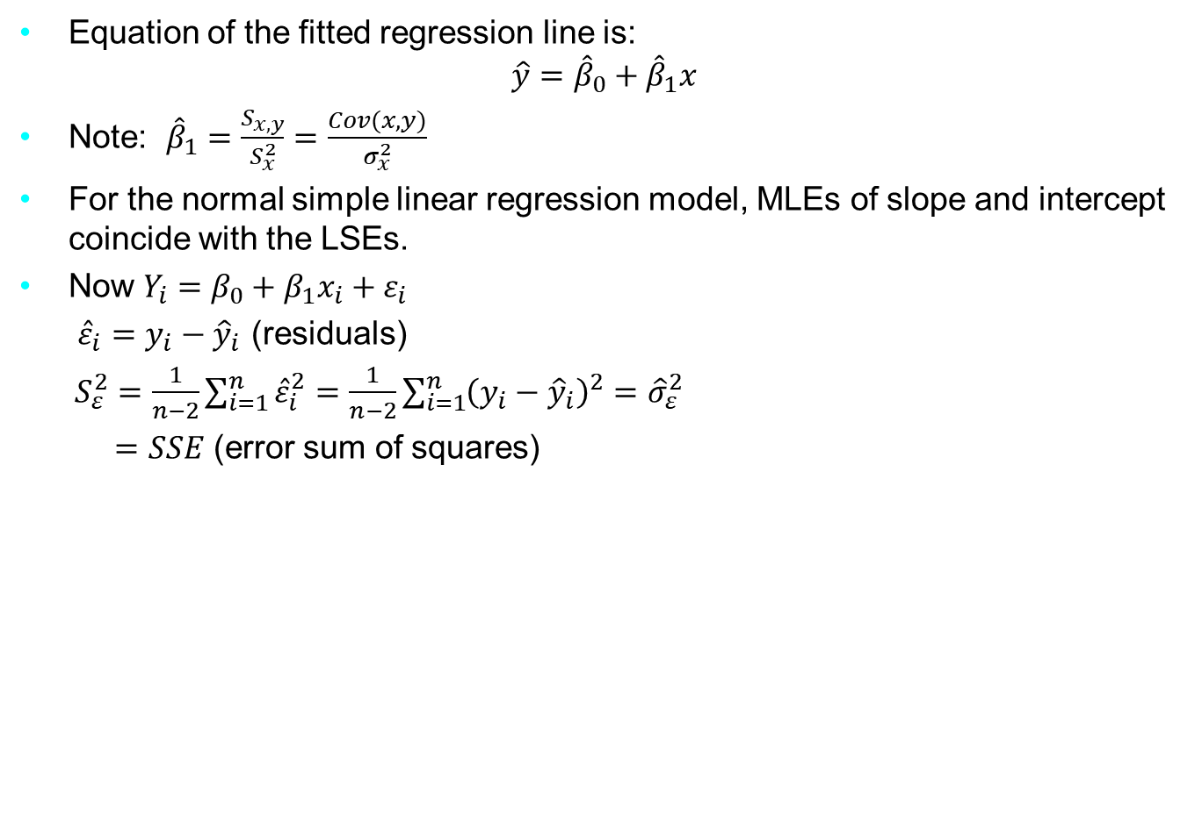
Method of Least Squares
Equation of the fitted regression line is:
$$\hat{y}={\hat{β}}_{0}+{\hat{β}}_{1}x$$
Note: ${\hat{β}}_{1}=\frac{S_{x,y}}{S_{x}^{2}}=\frac{Cov(x,y)}{σ_{x}^{2}}$
For the normal simple linear regression model, MLEs of slope and intercept coincide with the LSEs.
Now $Y_{i}=β_{0}+β_{1}x_{i}+ε_{i}$
${\hat{ε}}_{i}=y_{i}−{\hat{y}}_{i}$ (residuals)
$S_{ε}^{2}=\frac{1}{n−2}\sum_{i=1}^{n}{{\hat{ε}}_{i}^{2}}=\frac{1}{n−2}\sum_{i=1}^{n}{{\left(y_{i}−{\hat{y}}_{i}\right)}^{2}}={\hat{σ}}_{ε}^{2}$
$=SSE$ (error sum of squares)
Notes:
The genetic material that carries the instructions that allow cells to make proteins
Composed of a sugar phosphate backbone from which four nitrogenous bases- adenine (A), guanine (G), cytosine (C), and thymine (T) protrude
Arranged in a double helix- two strands are held together by specific pairings between bases A – T pair and G – C pair

Slide 6
Method of Least Squares
In R, the lm() function is used to fit linear models (glm() for GLMs)
Syntax: lm(fitting_formula, data frame)
summary(): to view the estimates from analysing the linear model
plot(): for viewing diagnostic plots and plotting raw data
abline(): overlaying with abline
predict(model, newdata, interval = ‘confidence’)
Example1:
> help(airquality)
> View(airquality)
> attach(airquality)
> model <- lm(Ozone ~ Solar.R, data=airquality)
> plot(Solar.R, Ozone)
> summary(model)
etc…..
Notes:
The genetic material that carries the instructions that allow cells to make proteins
Composed of a sugar phosphate backbone from which four nitrogenous bases- adenine (A), guanine (G), cytosine (C), and thymine (T) protrude
Arranged in a double helix- two strands are held together by specific pairings between bases A – T pair and G – C pair

